Slide 1
MULTIPLE SEQUENCE Alignments
GS. TS. Lê Sỹ Vinh
(some contents are from internet)

Slide 2
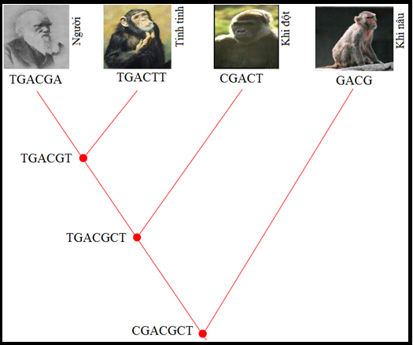
Evolution
 | 1 | 2 | 3 | 4 | 5 | 6
Người | T | G | A | C | G | T
Tinh tinh | T | G | A | C | T | T
Khỉ đột | C | G | A | C | T
Khỉ nâu | G | A | C | G
DNA sequences obtained from 4 species
The evolution of DNA sequences

Slide 3
Multiple sequence alignment (MSA)
Insert gaps ‘-’ into all sequences such that they have the same length
All nucleotides at the same position are homologous
The aligned sequences are highly similar
 | 1 | 2 | 3 | 4 | 5 | 6
Người | T | G | A | C | G | T
Tinh tinh | T | G | A | C | T | T
Khỉ đột | C | G | A | C | − | T
Khỉ nâu | − | G | A | C | G | −
A multiple sequence alignment of 4 DNA sequences

Slide 4
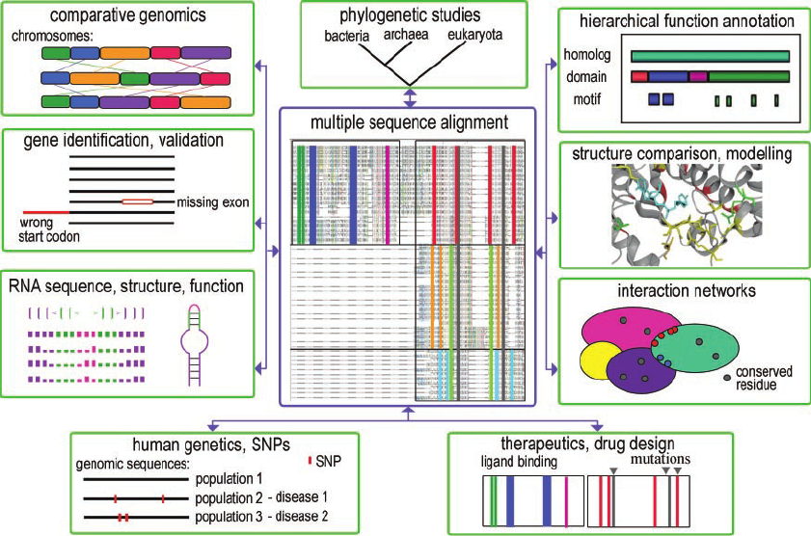
Why do we need MSA
Phylogenetic tree reconstruction
Structure prediction
Motifs/Patterns discovery
Which parts “do the same thing”?
Detecting new homologies between new genes and established sequence families
MSA is central to many bioinformatics applications

Slide 5
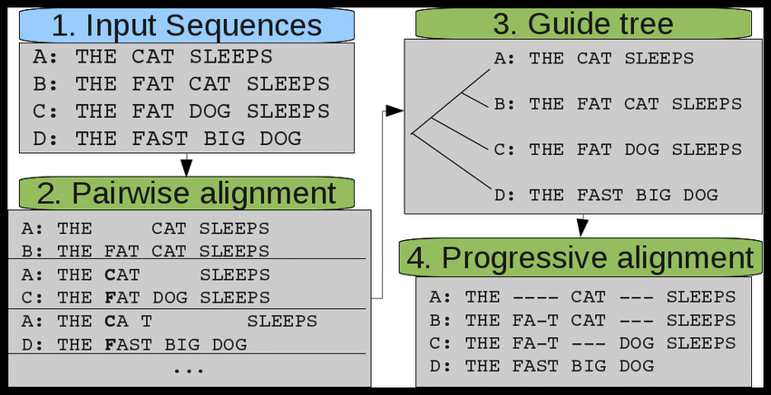
How to align multiple sequences
Dynamic programming
Generalization of Needleman-Wunsch
Find alignment that maximizes a score
Function Global Progressive Alignments
Match closely-related sequences first using a guide tree

Slide 6
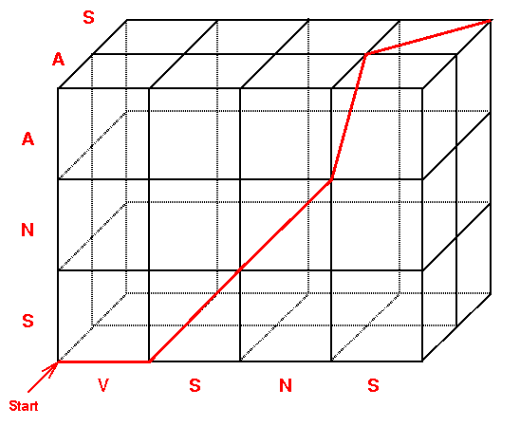
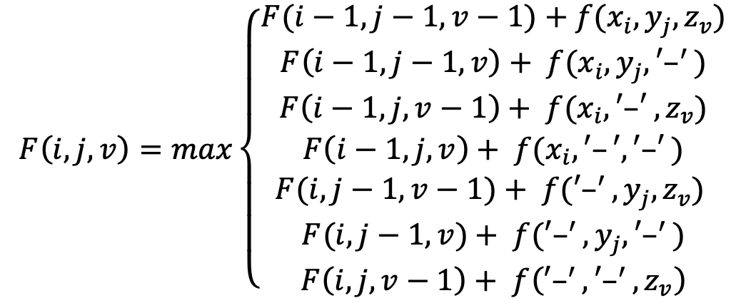

Dynamic programming to align three sequences
$x_{i}, y_{j}, z_{v}$ at the same position
$x_{i}, y_{j}, ′–′$ at the same position
$x_{i}, ′–′, z_{v}$ at the same position
$x_{i}, ′–′, ′–′$ at the same position
$′–′ , y_{j}, z_{v}$ at the same position
$′–′ , y_{j}, ′–′$ at the same position
$′–′ , ′–′, z_{v}$ at the same position

Slide 7

Dynamic programming to align three sequences
Calculate the $F(i,j,v)$scores and align the three following sequences
$X$ = AGCT
$Y$ = ACT
$Z$ = GCT
$x_{i}, y_{j}, z_{v}$ at the same position
$x_{i}, y_{j}, ′–′$ at the same position
$x_{i}, ′–′, z_{v}$ at the same position
$x_{i}, ′–′, ′–′$ at the same position
$′–′ , y_{j}, z_{v}$ at the same position
$′–′ , y_{j}, ′–′$ at the same position
$′–′ , ′–′, z_{v}$ at the same position

Slide 8
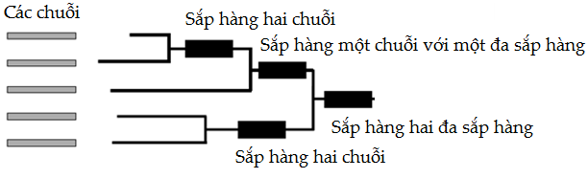
Progressive alignment

Slide 9
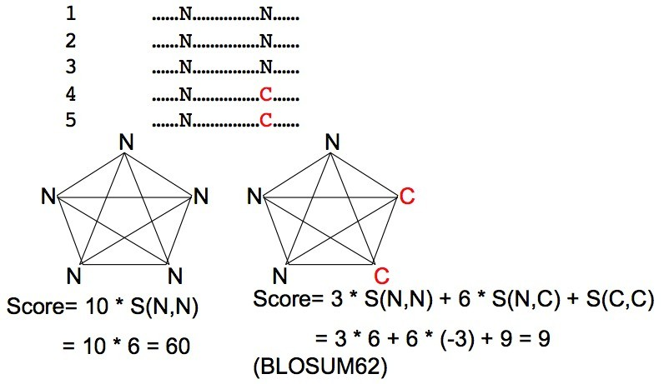
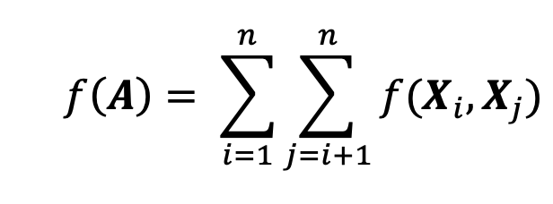
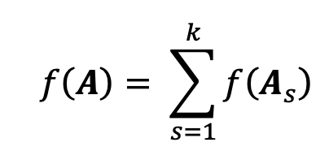
Multiple alignment score: sum of pairs

Slide 10
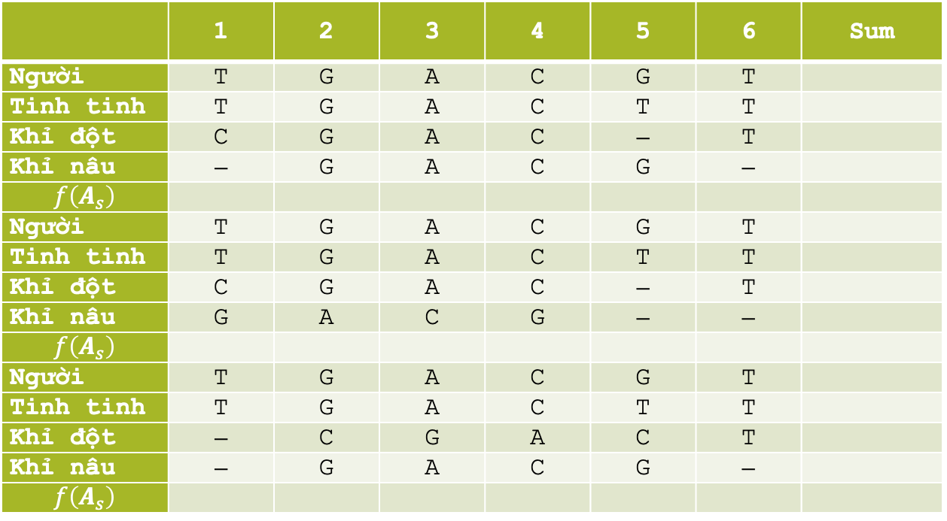
Multiple sequence alignment score
 | 1 | 2 | 3 | 4 | 5 | 6 | Sum
Người | T | G | A | C | G | T
Tinh tinh | T | G | A | C | T | T
Khỉ đột | C | G | A | C | − | T
Khỉ nâu | − | G | A | C | G | −
$$f\left(A_{s}\right)$$
Người | T | G | A | C | G | T
Tinh tinh | T | G | A | C | T | T
Khỉ đột | C | G | A | C | − | T
Khỉ nâu | G | A | C | G | − | −
$$f\left(A_{s}\right)$$
Người | T | G | A | C | G | T
Tinh tinh | T | G | A | C | T | T
Khỉ đột | − | C | G | A | C | T
Khỉ nâu | − | G | A | C | G | −
$$f\left(A_{s}\right)$$
Calculate the score of above MSAs with the following score system
match: 2
mismatch:-1
indel:-2

Slide 11
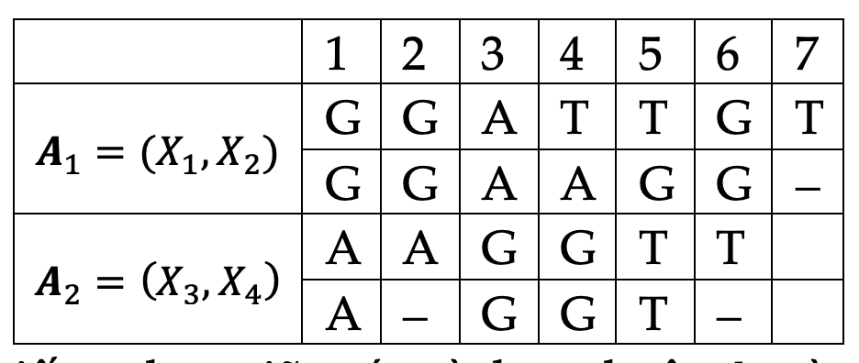


The similarity between two multiple sequence alignments
$A_{x}=\left(X_{1},…,X_{p}\right)$ and $A_{y}=\left(Y_{1},…,Y_{q}\right)$
Similarity$\left(A_{x}, A_{y}\right)=\max{\{f\left(X_{i}, Y_{j}\right), 1≤i≤p; 1≤j≤q\}}$
Similarity$\left(A_{1}, A_{2}\right)$ = ?

Slide 12
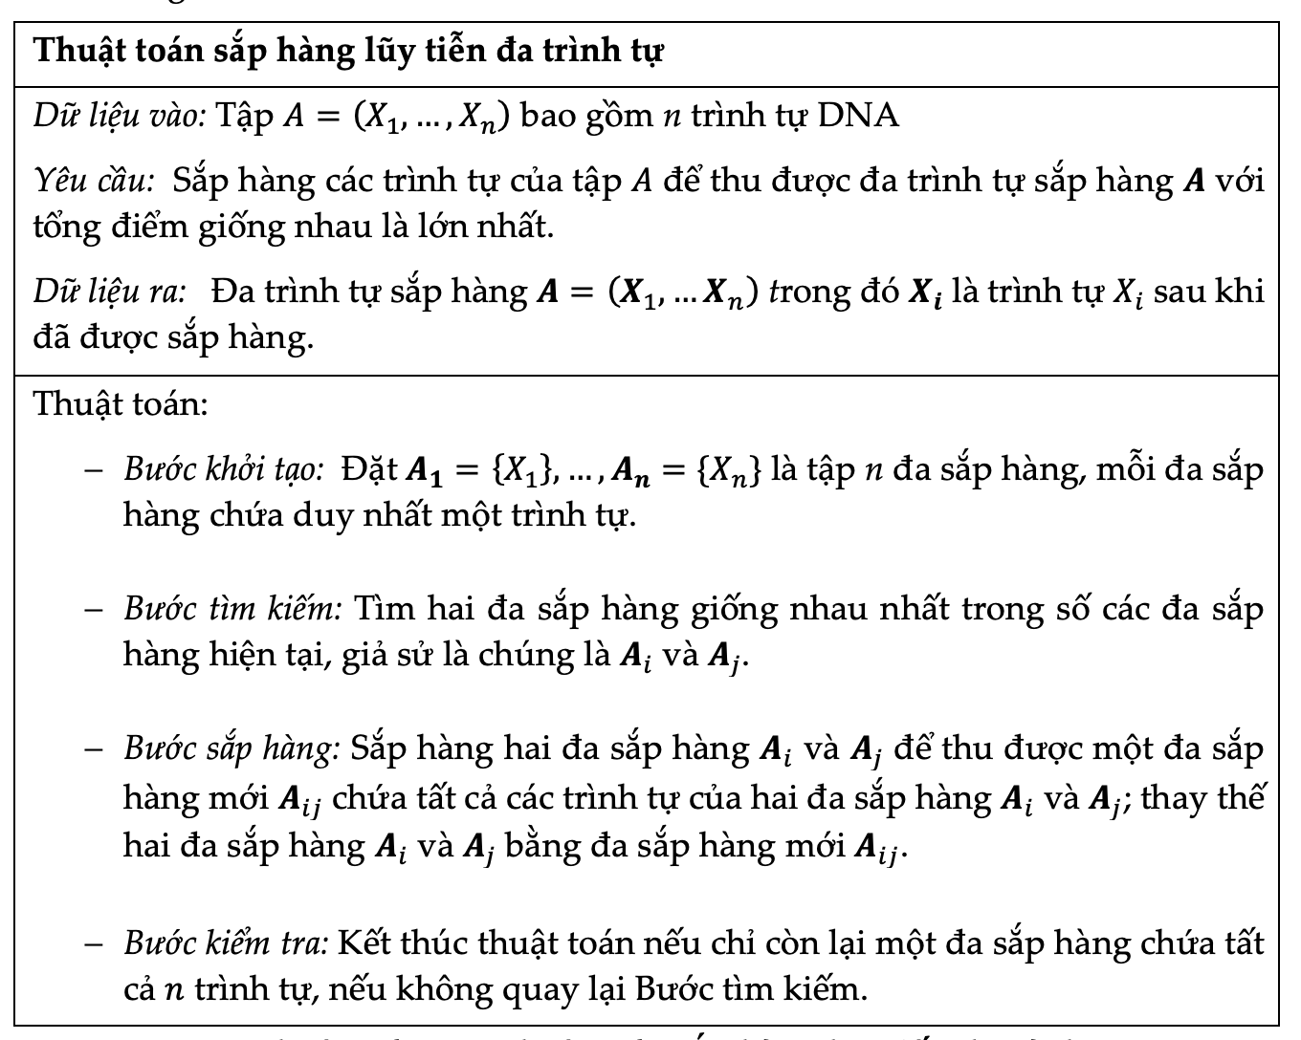
Progressive alignment alignment

Slide 13

Exercise
$X_{1}="GGATTGT”$
$X_{2}="GGAAGG”$
$X_{3}="AAGGTT”$
$X_{4}="AGGT”$
Align the four sequences with following score system:
match: 2
mismatch:-1
indel:-2

Slide 14
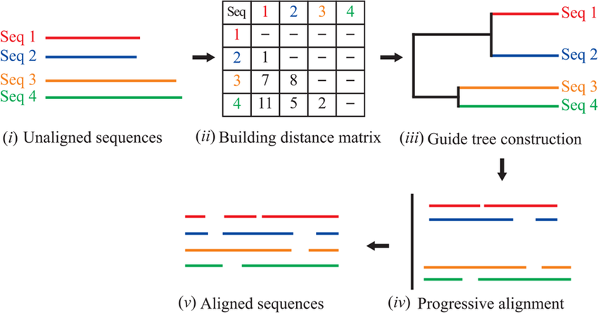
Progressive alignment: ClustalW

Slide 15
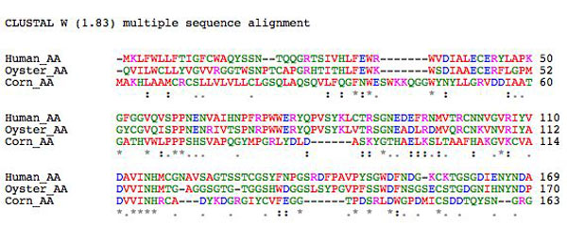
Multiple sequence alignment: ClustalW format

Slide 16
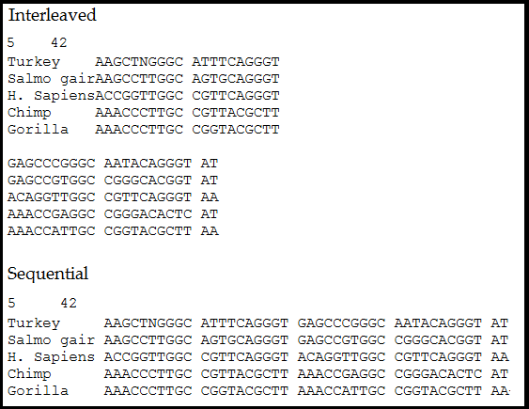
Multiple sequence alignment: Phylip format
Note: The sequence name has exact 10 characters

Slide 17
Exercise
Download FOXP2 genes of human and 10 species close to the human. Align and download the multiple sequence alignment of the sequences using the ClustalW algorithm
Download Myosin proteins of human and 10 species close to the human. Align and download the multiple sequence alignment of the sequences using the ClustalW algorithm

Slide 18
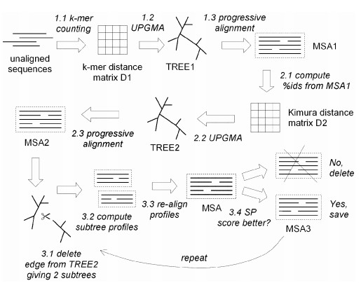
Progressive alignment: Muscle

Slide 19
Exercise
Download P53 genes of human and 10 species close to the human. Align and compare their multiple sequence alignments using ClustalW and Muscle algorithms.
Download Cytochrome C proteins of human and 10 species close to the human. Align and compare their multiple sequence alignments using ClustalW and Muscle algorithms.

Slide 20
Algorithm comparison
Describe the ClustalW algorithm
Describe the Muscle algorithm
How to reconstruct guide trees in the ClustalW and Muscle algorithms?
Compare the advantages and disadvantages of ClustalW and Muscle algorithms

